Slide 1

VETRI VINAYAHA COLLEGE OF ENGINEERING AND TECHNOLOGY
ANNA UNIVERSITY : CHENNAI OCT 2023

Slide 2
SUBMITTED BY
SARAVANAN S 623320104020
KABILAN M 623320104010
KAVIYARASAN M 623320104013
SOWMIYA R 623320104022
Guided by
Mr.SURIYA
AP/CSE

Slide 3
PROJECT TITLE
BIOMETIC SECURITY SYSTEM FOR VOTING PLATFORM

Slide 4
INTRODUCTION
In today's digital age, securing the electoral process and ensuring the integrity of each vote has become paramount.
With increasing concerns about electoral fraud, impersonation, and unauthorized voting, there's a pressing need for a robust, tamper-proof, and transparent system.
This project proposes the development of a Biometric Security System for a Voting Platform that capitalizes on the uniqueness of individual physiological attributes
By successfully implementing this system, we envision a future where voters can confidently participate in elections, knowing their vote is secure, counted, and transparently recorded, and where electoral bodies can reliably and efficiently manage the entire process.

Slide 5
EXISTING SYSTEM
The existing voting systems are plagued by a range of critical issues that compromise the integrity of elections and erode public trust.
Traditional methods of identity verification often rely on paper-based documents or simple forms of identification, leaving elections vulnerable to fraudulent activities such as voter impersonation and multiple voting.
These vulnerabilities not only threaten the legitimacy of election outcomes but also cast doubt on the democratic process itself.
The handling of sensitive voter data in centralized databases raises concerns about data breaches and privacy violations, leaving voters exposed to potential identity theft and misuse of their personal information.

Slide 6
EXISTING SYSTEM DISADVANTAGES
Its vulnerability to fraud, impersonation, and lack of transparency. Traditional paper-based systems often struggle to verify voter identities effectively, making it challenging to prevent multiple voting and ensure the integrity of the electoral process.
Additionally, the centralized storage of voter data poses data security and privacy risks, and the absence of a tamper-proof record system makes it difficult to address concerns about election fairness and transparency.
Handling absentee or remote voting in existing systems can be complex, involving mailing paper ballots and verifying the legitimacy of such votes.

Slide 7
PROPOSED SYSTEM
Biometric Security System For Voting Platform A biometric security system for a voting platform is a cutting-edge solution that leverages unique physiological or behavioral characteristics.
During registration, individuals' biometric data is securely stored, creating a binding link between their identity and their biometric template.
On election day, voters undergo biometric authentication, ensuring that only eligible individuals cast their ballots. Privacy, data security, and accessibility considerations are paramount, along with the need for fallback mechanisms in case of authentication failures.
This system not only enhances election security but also bolsters public trust and transparency, ushering in a new era of secure and reliable voting procedures.

Slide 8
PROPOSED SYSTEM ADVANTAGES
It offers numerous advantages, including enhanced security, transparency, and accessibility. It ensures the authentication of voters through biometric data, reducing the risk of fraud and impersonation.
The use of blockchain technology provides a tamper-proof and transparent ledger, increasing trust and confidence in the electoral process.
Furthermore, the system offers voters control over their data, protecting privacy and allowing for more inclusive voting methods.
This project advances election security and transparency while adapting to the evolving needs of modern democracy

Slide 9
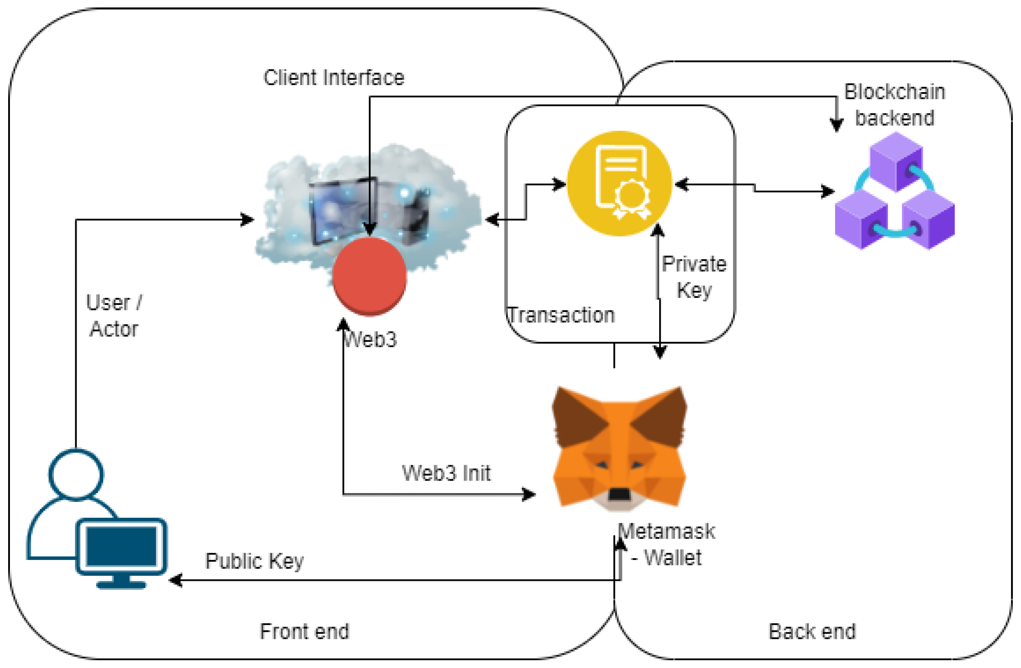
SOLUTION ARCHITECTURE

Slide 10
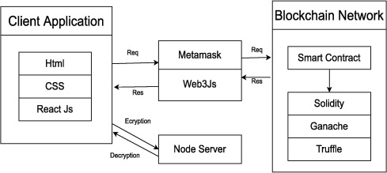
FLOW DIAGRAM
RREMIX IDE

Slide 11
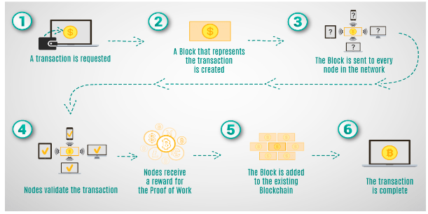
TECHNICAL ARCHITECTURE

Slide 12
CONCLUSION
The "Biometric Security System for Voting Platform with Blockchain Integration" project presents a cutting-edge solution to address critical challenges in the current voting systems.
By combining biometric authentication and blockchain technology, it ensures robust voter verification, enhances election security, and fosters transparency and trust in the electoral process.
While offering significant advantages in terms of security and privacy, the project also faces challenges related to technology adoption, cost, complexity, and regulatory compliance.
A successful implementation would mark a significant step toward revolutionizing the integrity and accessibility of elections.

Slide 13
FUTURE SCOPE
The project's future scope includes the potential for wider adoption of biometric- and blockchain-based voting systems, contributing to more secure, transparent, and accessible elections worldwide.
This technology could evolve to accommodate remote and mobile voting, offering a more inclusive and convenient approach to civic participation while maintaining the integrity of the electoral process.
Additionally, ongoing research and development in blockchain and biometrics may lead to enhanced security, scalability, and usability, further strengthening the foundation for future electoral systems.

Slide 14
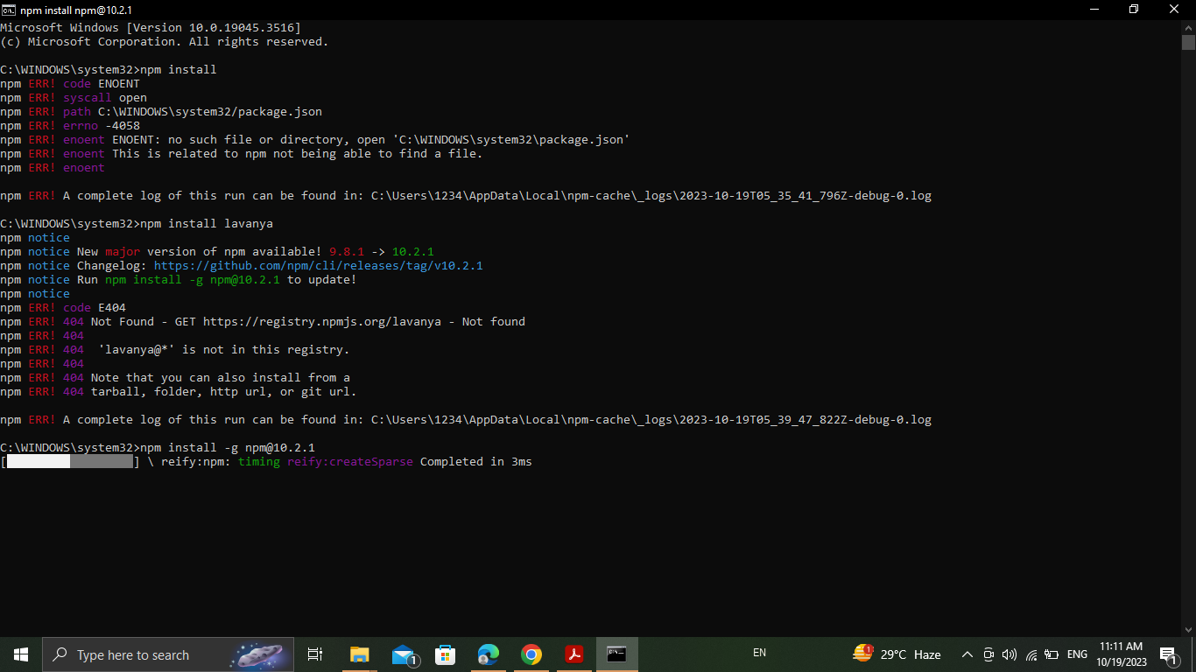
OUTPUT

Slide 15


Slide 16
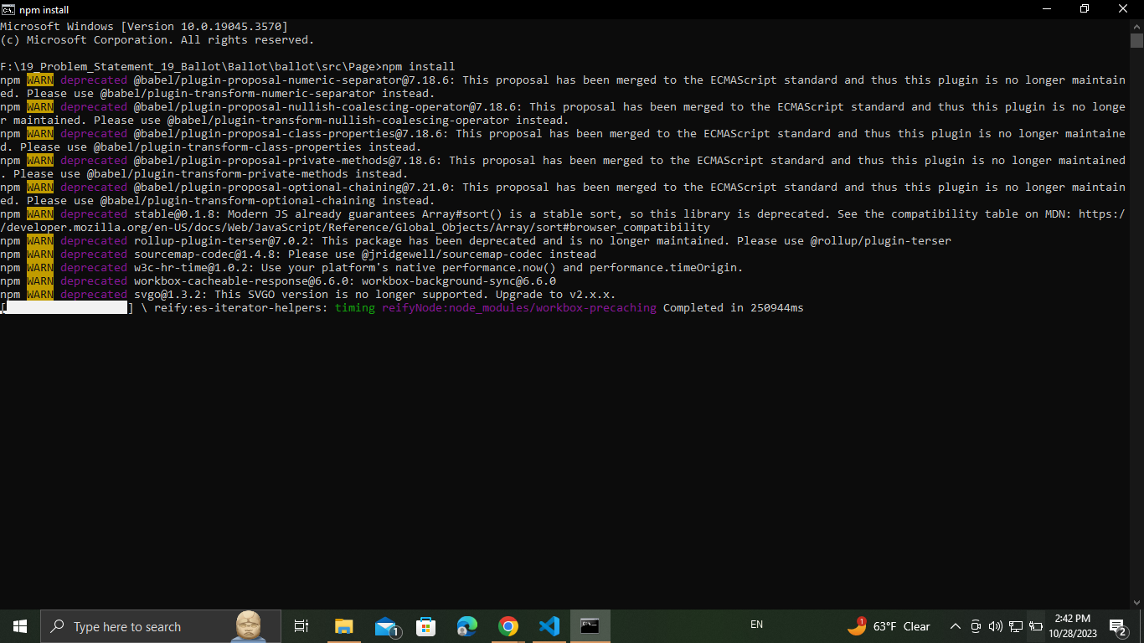

Slide 17


Slide 18
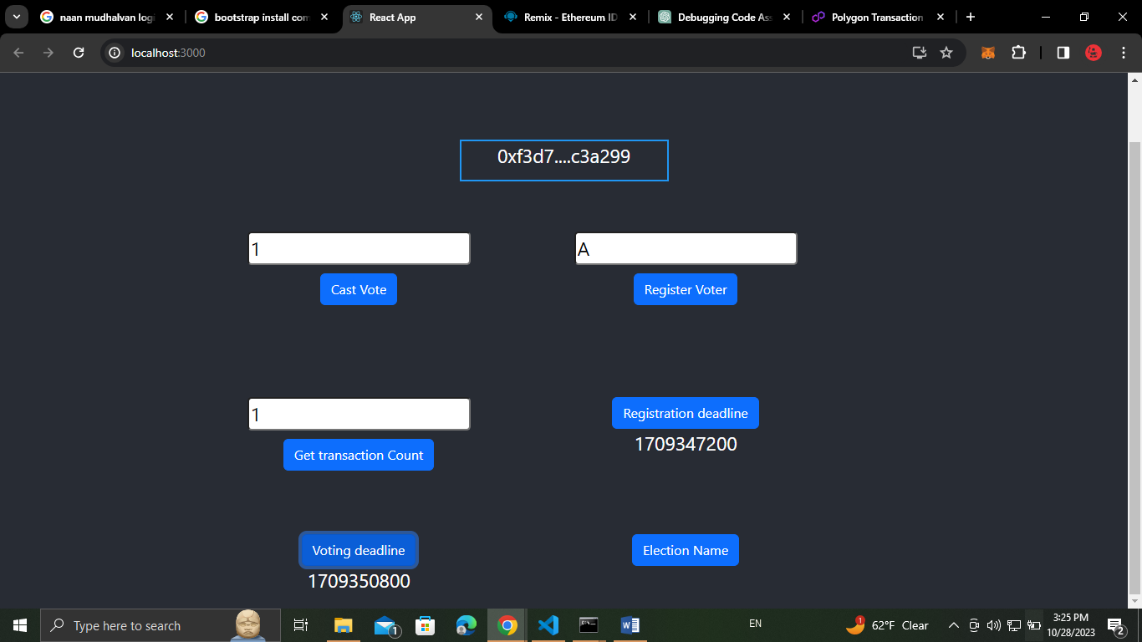

Slide 19
THANK YOU

